Slide 1
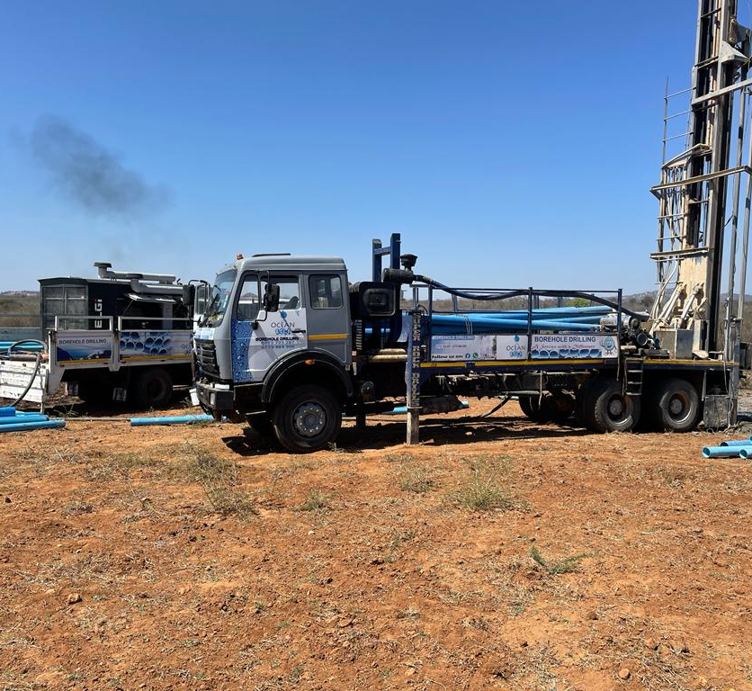
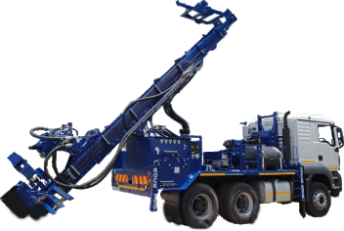



OCEAN ROCK DRILLING
COMPANY PROFILE
Providing efficient, sustainable and affordable water & solar solutions to the whole of Zimbabwe

Slide 2

OceAN rock borehole drilling & SOLAR
Introduction
Vision, Mission and Values
Ocean Rock Drilling & Solar is a water drilling and solar energy company in Zimbabwe with wealth of experience in Borehole Siting, Borehole Drilling & Installation, Piped Water Schemes, Solar installations, Capacity testing and general borehole assessment and repairs. Our aim is to provide quality, clean water and boreholes that can be well maintained and be handed over to future generations. The Company was formally incorporated on 18 February 2021 with the objective of offering quality services in the field of ground water exploration, borehole drilling and borehole installation in the most efficient and ethical manner. A clean water supply is essential for a healthy population and improves the overall well being of general population. In addition, a reliable water supply goes a long way in advancing sustainable economic development in agriculture and livestock hence playing a critical role in poverty eradiation, particularly in the rural areas. The company policy statement is anchored on the objective to ensure balanced social economic development in Zimbabwe in line with Millennium Development Goals (MDGs).
Vision
Improving people’s lives through bringing clean water in a sustainable and efficient manner in both domestic and commercial set ups.
Mission
Provide clean and sustainable water solutions to all the people of Zimbabwe and help transform previously excluded communities'
Values
Quality- we endeavour to provide services of a high quality and use materials that are SAZ approved
Teamwork- Our success hinges on the collective strength and effort of diverse skills and capabilities
Accountability- doing the right thing the first time and holding ourselves accountable for the results

Slide 3
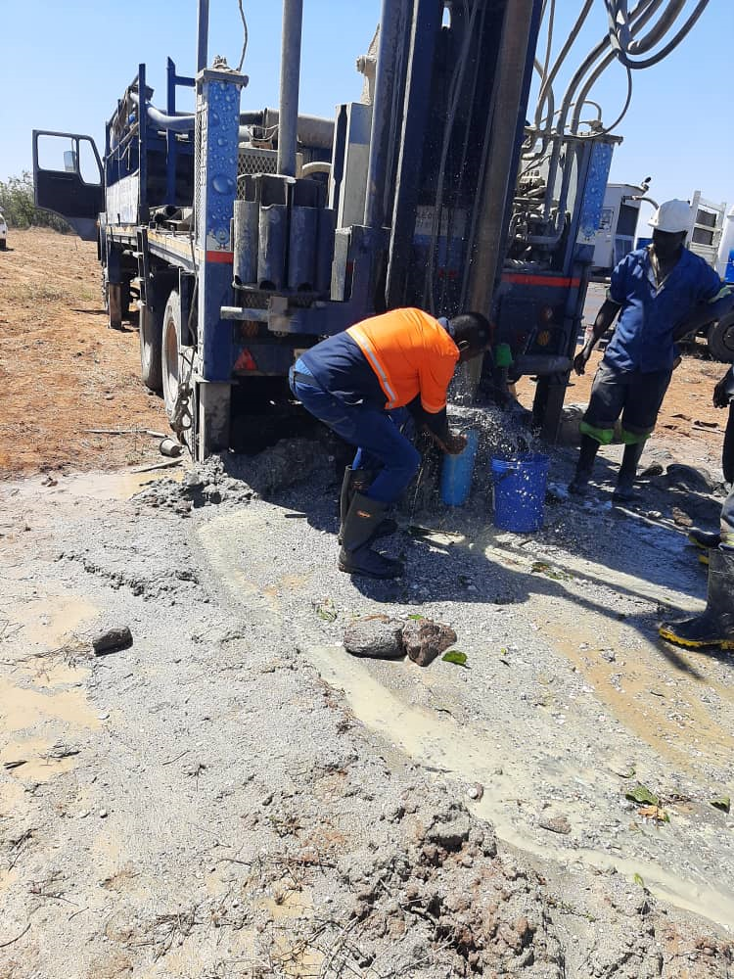
About uS
Ocean Rock Drilling is a professional drilling company in the area of ground survey, drilling and installation. Our services range from scientific water surveys, borehole drilling, solar and electric borehole installations, capacity testing and borehole repair and maintenance.
Our engineering and sales teams are deeply experienced and motivated to offer excellent client service consistently. The technical team has in depth knowledge of the various geographical terrain and formations on the Zimbabwean landscape to recommend the correct drilling method and casing profile. We have a +95% success record on drilling right the first time with excellent water yields.
Ocean Rock Borehole Drilling is well equipped to provide generational boreholes that can provide water for domestic uses, horticultural projects, nutritional gardens, dip tanks, fishery projects, pastures, and community water points across the Country.
We have heavy duty rigs and small portable rigs to suit every client scenario anywhere in Zimbabwe.
Notes:
© Copyright Showeet.com – Free PowerPoint Templates

Slide 4
The TEAM
OCEAN ROCK DRILLING
SENIOR MANAGEMENT TEAM
Managing Director
A qualified Chartered Accountant with extensive finance and general management experience with listed and global companies. Previously worked in the USA and Botswana for Big 4 Accounting companies
J.PANGANAI
DRILLING FOREMAN
SENIOR SURVEYOR
GM SALES
GM BUSINESS DEVELOPMENT
MEMBER G. CHIZUZU
MEMBER M. NYAMBAYO
MEMBER M. BURE
MEMBER B CHIDARI
Has been in the drilling industry for more than 30 years in the drilling industry. He was previously with DFF where he was responsible for both drilling and borehole installations services
Has been involved in survey projects since 2015 and worked on projects for key organizations such as UNDP, World Vision, UNICEF, GOAL, CDTO and JAHNITER mainly on wet hole contracts
A n experienced sales operative responsible for end-to-end customer onboarding and service
Experienced business practitioner with extensive experience in business development and sales in insurance and general sakes
Notes:
© Copyright Showeet.com – Free PowerPoint Templates

Slide 5
OUR SERVICES
WATER SURVEY
BOREHOLE DRILLING
Scientific water surveys anywhere in Zimbabwe. We use Terrameter and PQWT machines and supplement these tools with qualitative analysis of the geographical features and formations
We do both domestic and commercial boreholes. Our boreholes are cased from top to bottom using high quality borehole casings for both class 6 and class 10 as client requirements
BOREHOLE INSTALLATION
BOREHLOLE SERVICES
We do both Solar and Electric borehole installations including piped water schemes. We are also experts in bush pump installations. We provide tank stands and tanks from reputable suppliers such as Driptech, Lamasat and Megapak
We offer borehole services such as capacity tests, repair and maintenance services including servicing bush pumps, flushing, throughout Zimbabwe
Notes:
© Copyright Showeet.com – Free PowerPoint Templates

Slide 6
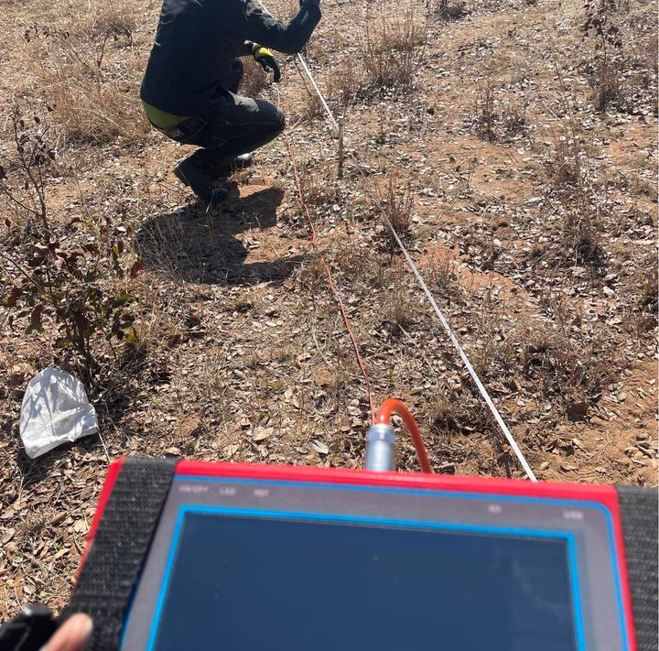
WATER SURVEY
We use scientific water survey methods with an accuracy level of +99%. We employ highly qualified and experienced surveyors with more than 20 years industry experience.
We use a combination of PQWT machines and Terrameter machines to conduct geo surveys.
Notes:
© Copyright Showeet.com – Free PowerPoint Templates

Slide 7
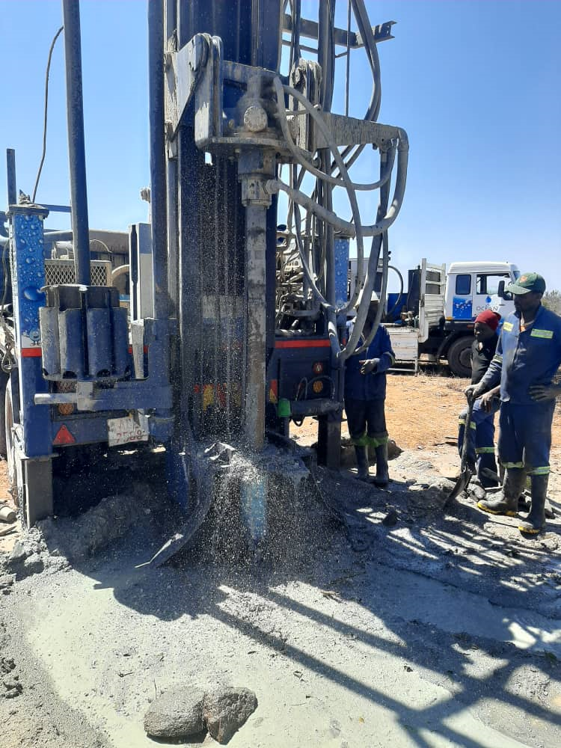

BOREHOLE DRILLING
Ocean Rock is experienced in drilling standard 140mm boreholes as well as commercial boreholes with wider diameter holes.
We have both heavy duty and baby rigs to be able to access confined spaces. No job is too big or too small for Ocean Rock Drilling
Our drilling methodology is that of casing a borehole from top to bottom, wherever possible.
We also recommend double casing to the bedrock using the 180mm diameter casings. We make us of SAZ approved casing from leading plastics company(Driptech and Proplastics amongst others)
Notes:
© Copyright Showeet.com – Free PowerPoint Templates

Slide 8
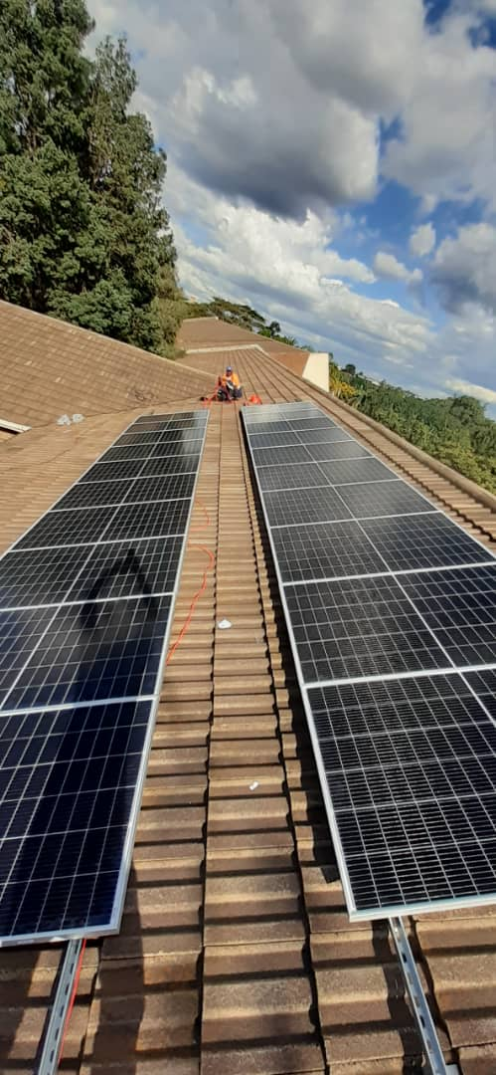
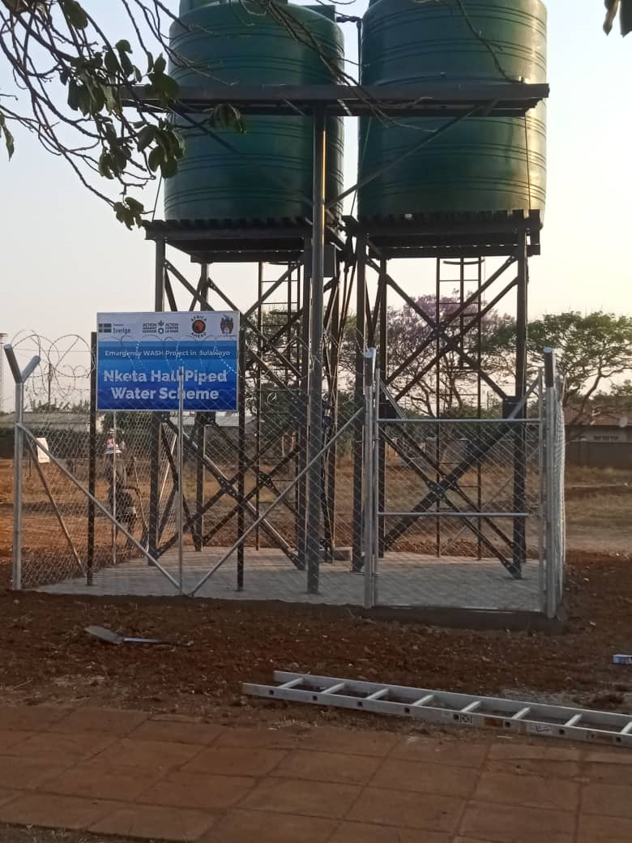
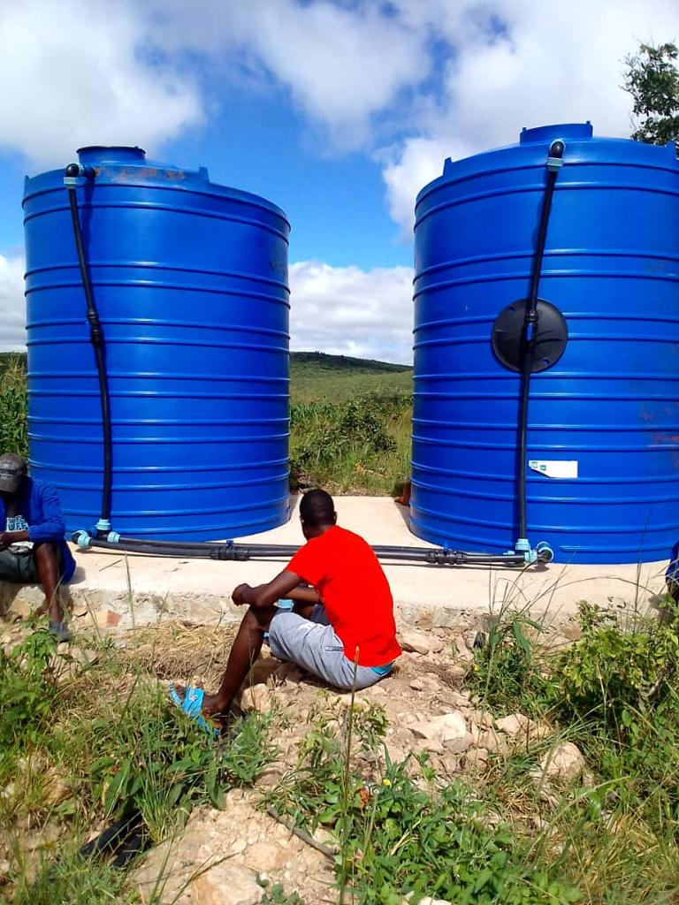
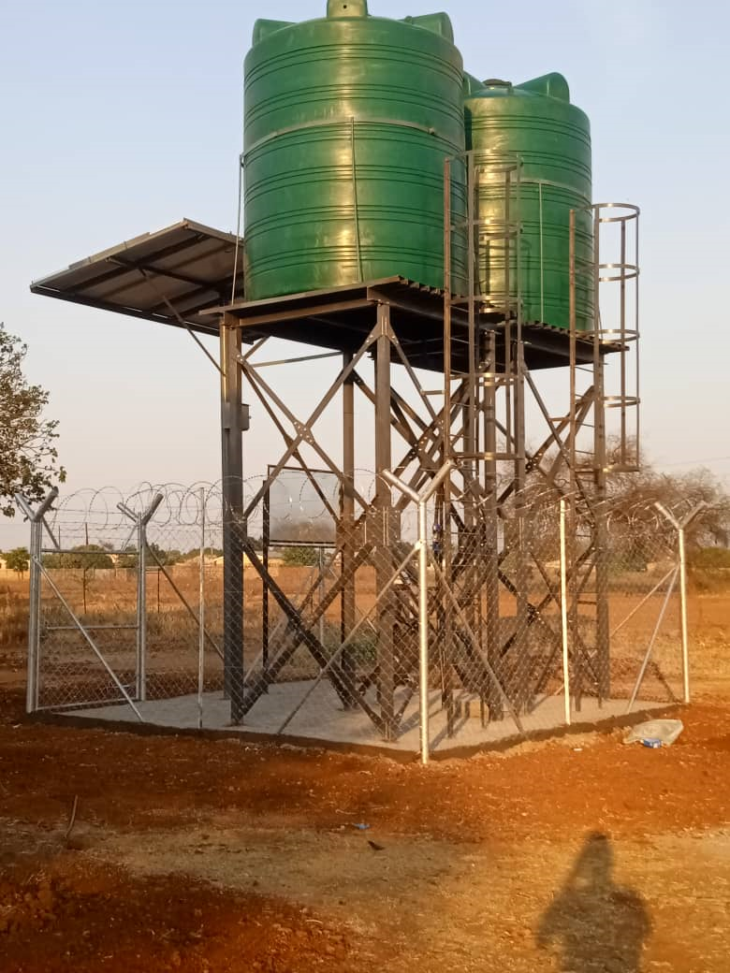
BOREHOLE INSTALLATIONS
We are experts in Solar & electric borehole installations, bush pump installations, booster pumps, and related technical work such designing the borehole installation to maximize on borehole efficiency.
We use galvanized steel tanks with a minimum height of 4m and only use tanks from reputable suppliers such Driptech, Megapak and Lamasat.
Notes:
© Copyright Showeet.com – Free PowerPoint Templates

Slide 9
OUR TRACK RECORD
WE HAVE OFFERED SERVICE TO NGOS, Individuals, SCHOOLS, HOSPITALS, COUNCILs and below ARE Some of our selected clients
PROJECT | SCOPE | Project size | Referee contact
Upper Manyame Sub Catchment Council (Harare & Mash East) (GVT) | Siting, Drilling & Installation | 4 X Community boreholes + Solar installations | K .Phiri +263712320362/3
Manyame RDC (Beatrice) | Solar Borehole installations | 3X Solar borehole installations | Mr Dzenga + 263773622230
Liquid Telecoms (Corporate) | Survey, Drilling & Installation | 80 metres+ Solar installation | H.Charakupa+263772557335
Chicken Slice (Corporate) | Borehole Drilling | 5X 100 metres Borehole drilling | T.Mutyebere +262772140564
Nyahunda Small Scale Farms (Bikita, Masvingo) | Survey and Borehole Drilling | 30X 60m boreholes+ Solar installations | T.Mbizvo (Coordinator) +263772816016
Mashoko Christian Hospital (NGO) | Borehole drilling and Installation | 3 X boreholes + Solar installation | Dr Madzanire +263773107696
Tobacco Research Board (TRB) | Borehole Siting and Drilling | 15X borehole capacity testing | Mr B.Muzoza-+263771112993
Africa Ahead (NGO) | Siting and Borehole Drilling | 6X Boreholes (Wethole)+ 7 piped Schemes | B.Dzingirai + 263775263377

Slide 10










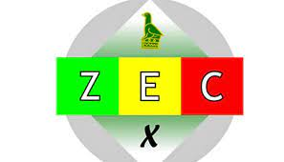

SOME OF THE Selected clients SERVED SO FAR

Slide 11
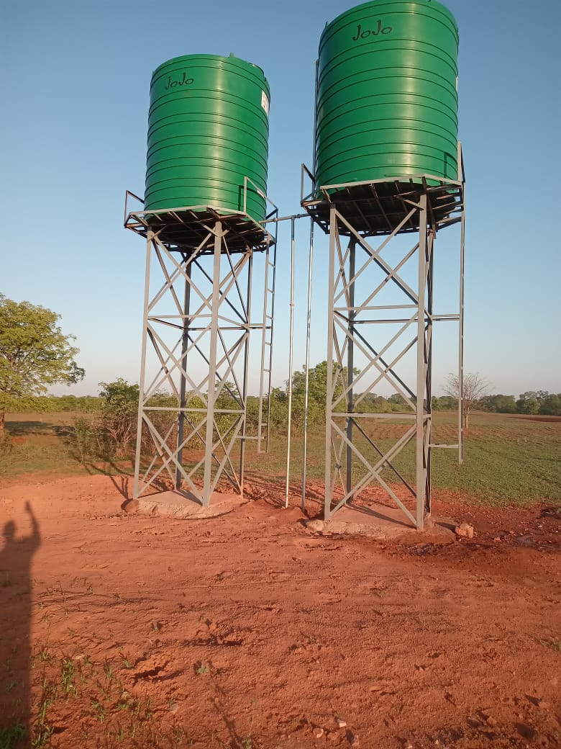
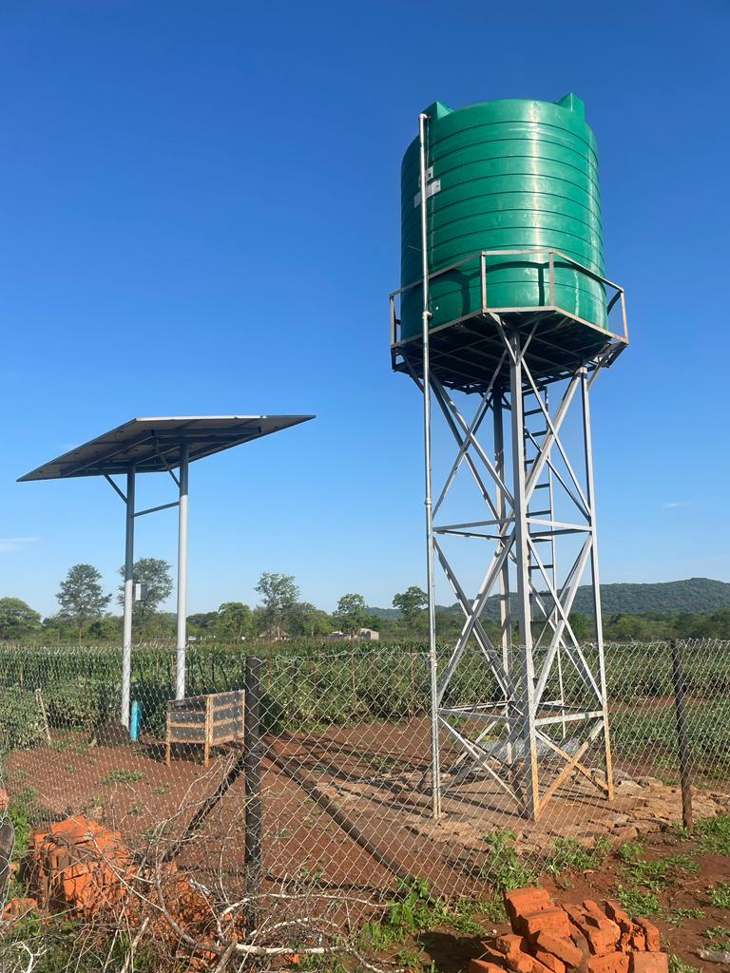
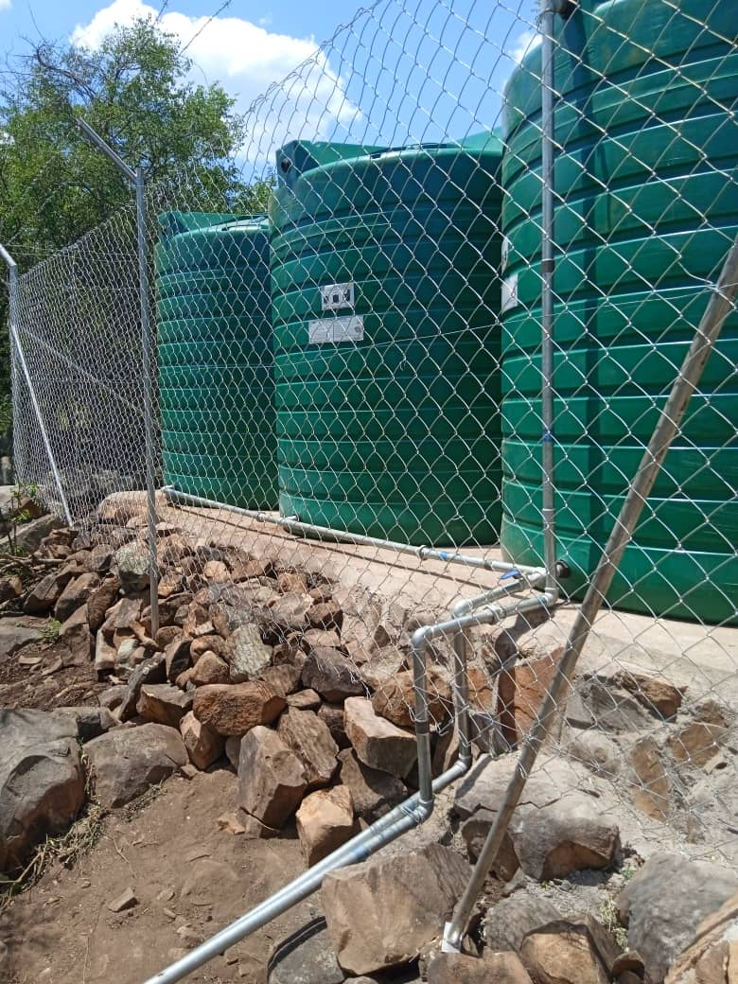
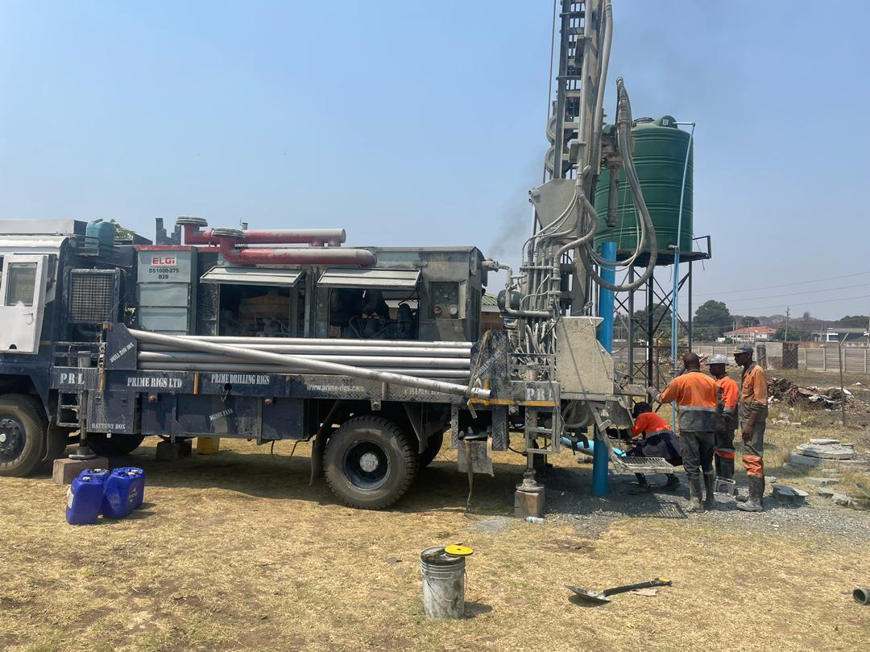
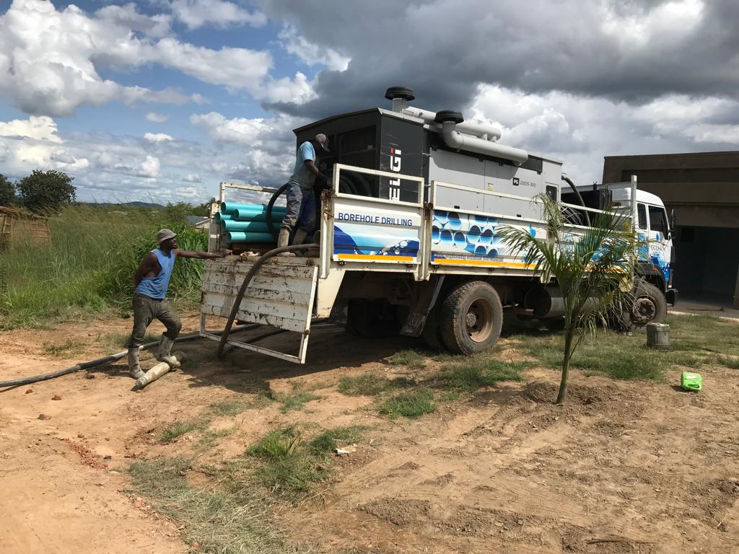

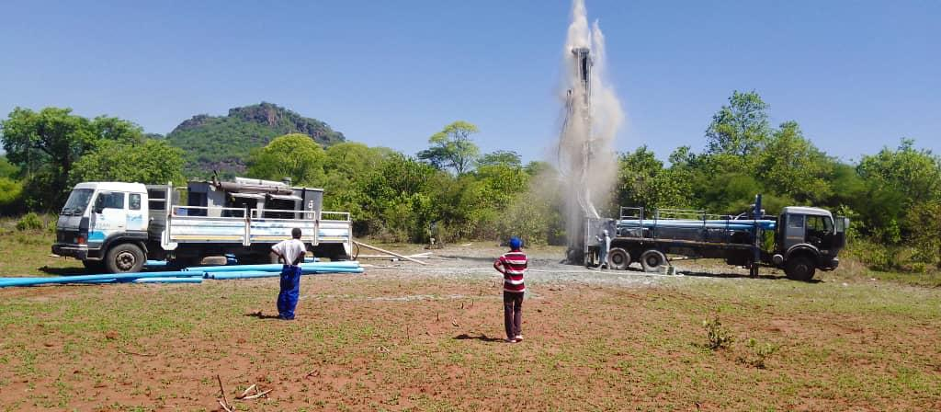
SOME OF OUR SELECTED WORKS

Slide 12
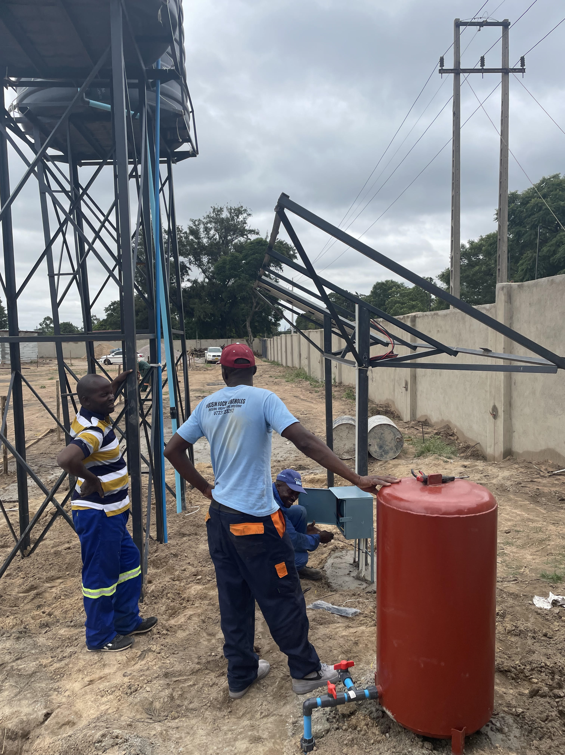
OUR EQUIPMENT
We are well equipped to deliver generation to generation boreholes at an affordable price

Slide 13
OUR CAPABLE EQUIPMENT
Ref | Equipment Name | Description | Supporting ownership document
1 | Super Rock 3000 Drill Rig mounted on a Powerstar Truck ACZ75008 | Heavy duty Super Rock drill rig with capacity to drill up to 400m | Registration books available for inspection
2 | PDTHR-200 DTH Cum Rotary Drill Rig mounted on an Ashok Leyland AFQ9327 | DTH Cum Rotary Drill Rig capable of drilling up to 200m | Registration books available for inspection
3 | TATA Compressor truck carrying 1100-300 Air Compressor | TATA rigid truck with registration AFE0335 with ELGI compressor supporting the Super Rock 3000 Drill rig | Registration books available for inspection
4 | ELGI 1100-300 psi Air Compressor mounted on UD Truck | Drill Compressor operating at 21 Bar supporting | Purchase agreement available for inspection
5 | ELGI 1000-275 psi Air Compressor | Drill Compressor operating at 20 Bar supporting the PDTHR-200DTH Cum Rotary Drill Rig | Purchase agreement available for inspection

Slide 14
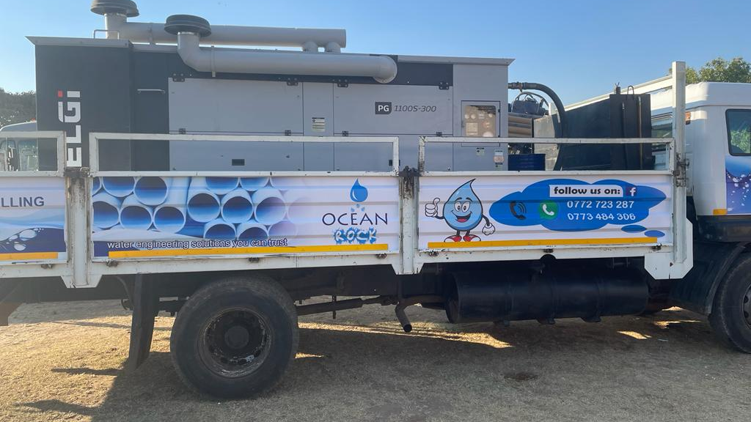
Truck mounted ELGI Compressor

Slide 15

Super Rock 3000 drill rig with +400m drilling depth capacity

Slide 16
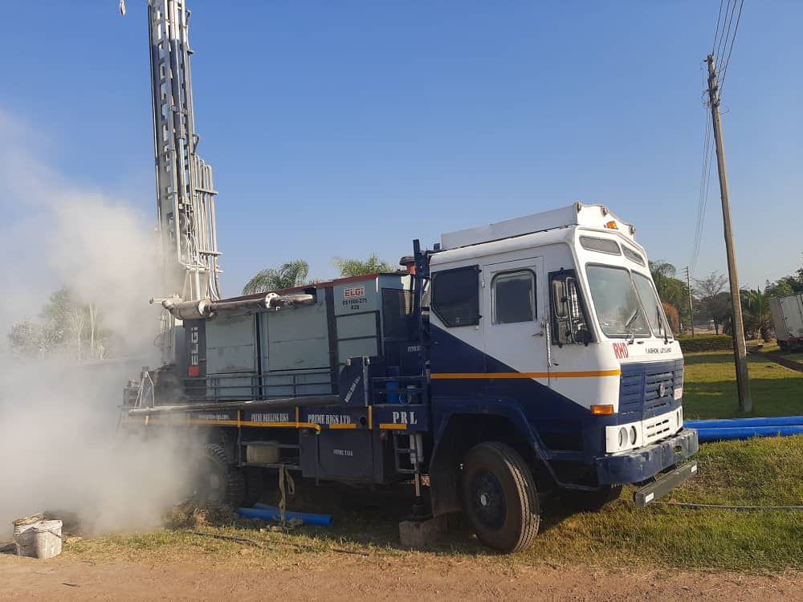
Ashok Leyland Drill Rig & Compressor with +200m drilling depth capacity

Slide 17
OUR TECHNICAL TEAMS
Ref | Name | Role | Experience
1 | George Chizuzu | Drilling Foreman & Senior Driller | +25 Years experience in drilling industry, most with DDF prior to joining Ocean Rock Drilling
2 | Prosper Mabiza | Senior Driller | +10 years drilling experience as Driller/Operator
3 | Vengai Ndlovu | Rig Truck Driver & Drill Assistant | +10 years drilling experience as a Driver and Compressor operator
4 | Alexander Zengenene | Senior Drill Assistant | +7 years drilling experience as a Drilling Assistant
5 | Tatenda Panganai | Rig Truck Driver & Drill Assistant | +3 years experience in driving, +3 years drilling experience
6 | Elisha Bure | Operations Supervisor | +5 years experience in customer service and team management

Slide 18
OUR TECHNICAL TEAMS
Ref | Name | Role
1 | Munyaradzi Nyambayo | Senior Hydrogeologist (BSc.Geology, UZ) | +10 years hydro survey experience and mineral exploration
2 | Pindai Shumba | Water Engineer (Bsc. Water Engineering (CUT) | +7 years experience as a water engineer
3 | Donald Paradza | Hydrogeologist (BSc.Geology, UZ) | +7 years hydro survey experience and mineral exploration
4 | Hardy Makuku | Senior Installations & Cap test Technician | +15 years’ experience in Solar/Electric borehole installations and Bush Pump Installations
5 | Alford Mpofu | Fabricator & Boiler Maker | +25 years’ experience in steel fabrication, designing and modification
6 | Paul Marwizi | Bush pump installations specialist | +25 years’ experience in Bush pump Installations and drilling, mostly with DDF prior to joining Ocean Rock Drilling

Slide 19
CONTACT US
Ocean Rock Drilling & Blasting (Pvt) Ltd
8309 Kirkman Gardens
Tynwald, Harare
+263772723287
+263773484306
0242329905
oceanicrockdrilling@gmail.com
https://www.facebook.com/Ocean-Rock-Borehole-Drilling-107364484935793/

